Slide 1
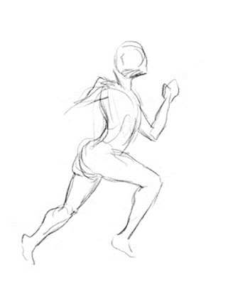
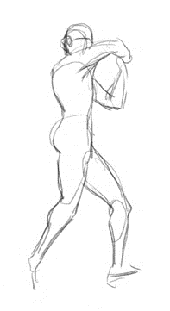
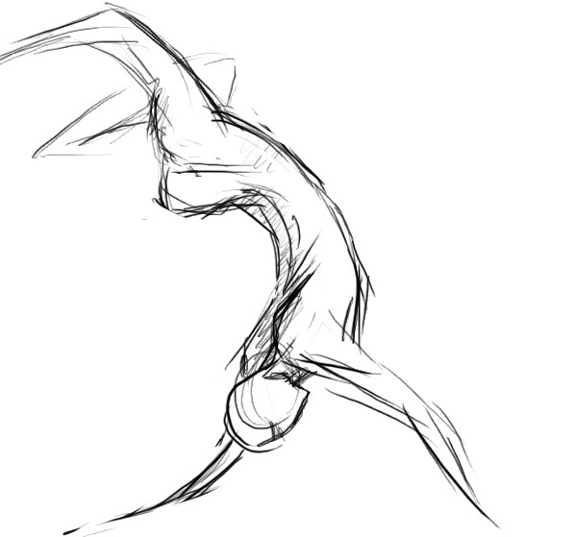
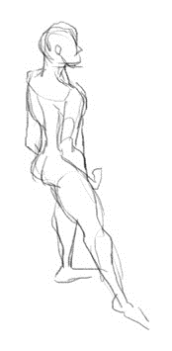
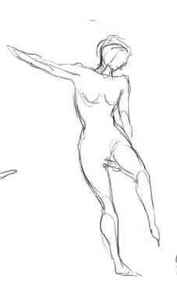
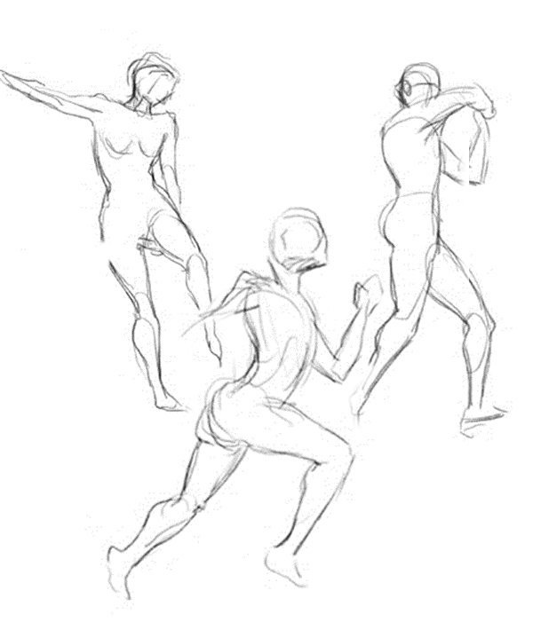
Prepose: Domain Specific Language for Building Kinect Gesture-based applications
Lucas Silva Figueiredo
Benjamin Livshits David Molnar
with help from
Margus Veanes and Loris d’Antoni

Slide 2
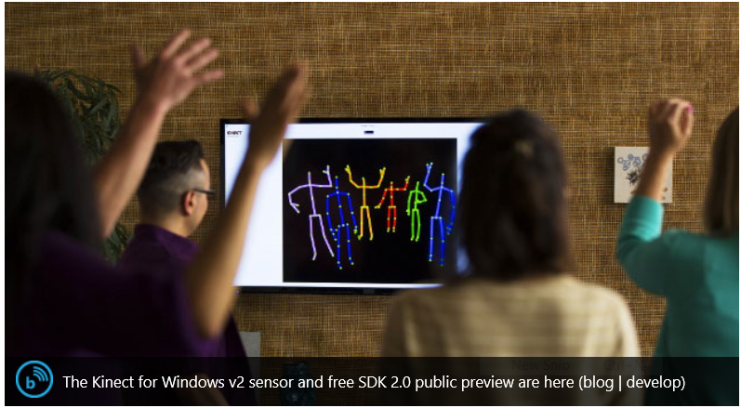
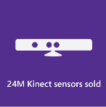
Kinect Enables Natural User Interface (NUI)

Slide 3
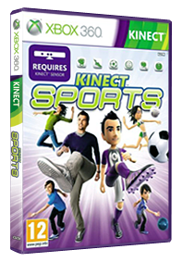

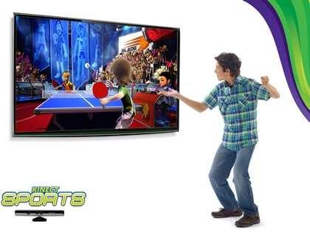
Gesture recognition Powers Kinect Apps

Slide 4
Problem: Building New Gesture Recognizers
// Punch Gesture
if ( vHandPos.z – vShoulderPos.z > fThreshold1 &&
fVelocityOfHand > fThreshold2 ||
fVelocityOfElbow > fThreshold3 &&
DotProduct( vUpperArm, vLowerArm) > fThreshold4 )
{
bDetect = TRUE;
}
Notes:
Hard coded gestures are the first try
Tunning may be a problem
Also they tend to be spread over the code,
Conflicts may arise, two gestures triggered at the same time
and developer will only know when testing it

Slide 5

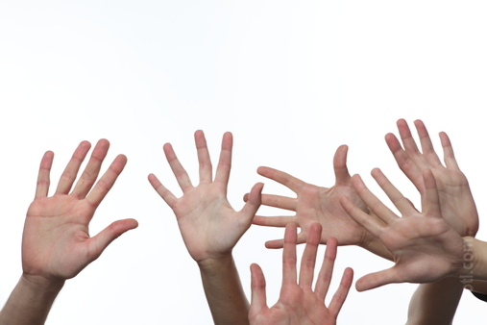

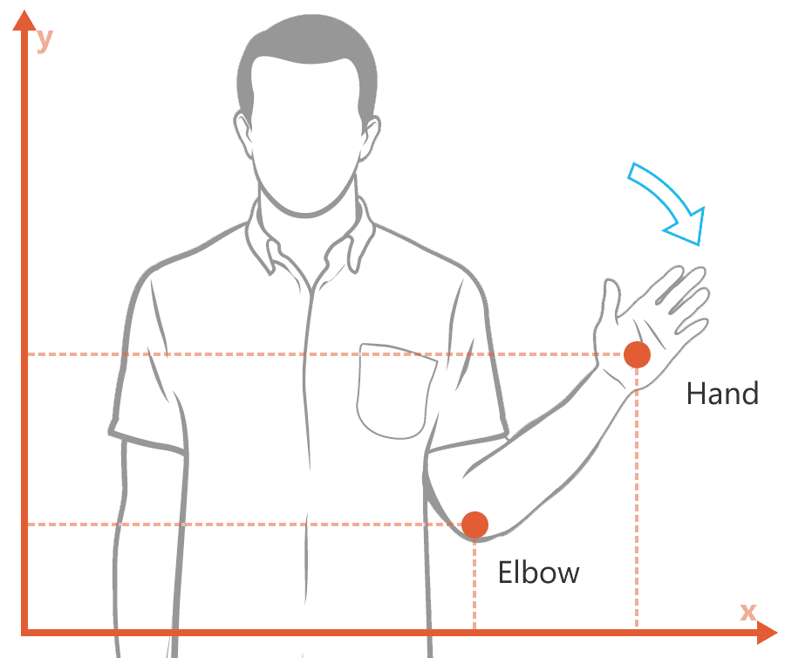





Problem: Building New Gesture Recognizers
KickBoxing:
25 recordings
Adults
15 male, 1 female
3 different environments
7 different camera angles
Each file
200–400 MB (50–100 MB compressed)
40–80 seconds long
~1,935 gestures
36,489 tracked skeleton frames
Machine Learning Approaches
Modeling Variations
ML Knowledge
Data Set Size
Recording and Tagging
Editing the Gesture
Recognition Time
Detailed Feedback
Conflicts
Notes:
State of the art is machine learning
They try to model variations of the gesture
If the data set is large enough the gesture coverage should be the best
Developers ML knowledge may be required
MS is doing a great job in that direction
Recording:
Painful gesture creation
Ambient setup
Volunteers
Training:
Tagging is manual, and usually requires a lot of time
Executing, testing and refining:
Editing is not possible
Consequently, prototyping usually takes a lot more of
Also, the time consumption during recognition may not be ideal for real time interaction
Not always the algorithm gives you feedback in which stage of the gesture the user is (adaboost vs random forest regression[rfr])
Conflicts are not solved here either

Slide 6
Our Approach
raise your left leg to the side
action
body part
direction
Notes:
Well defined grammar for gesture description

Slide 7
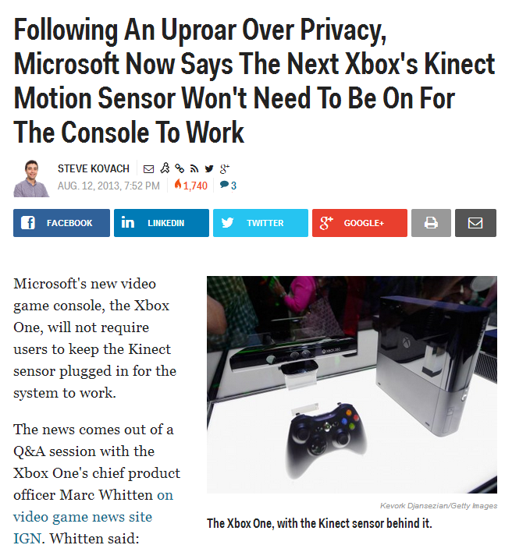
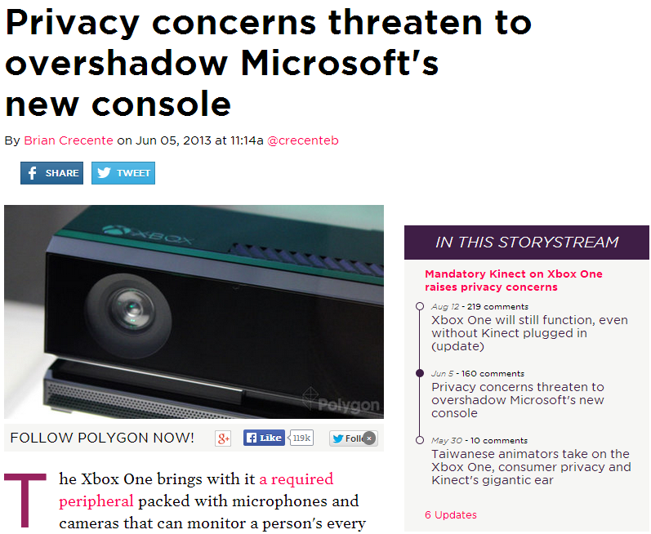
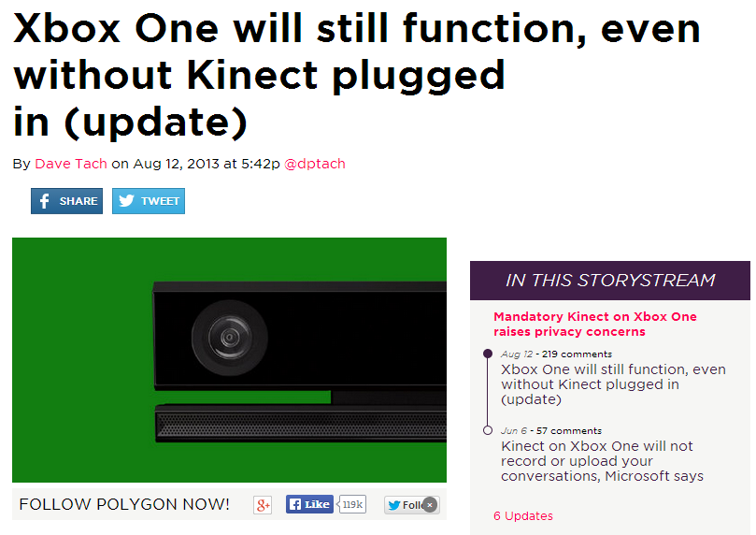
Problem: Privacy is a major concern
Notes:
Remembering, we have millions of these devices all over the world
Living rooms, bedrooms, offices
Raw data may be sent to apps
Xbox One always on Kinect
Console can be bought without Kinect now

Slide 8
Contributions
Prepose: a language for expressing gestures
A runtime for creating always-on training applications using Prepose
Support for user privacy built into system design
An approach to checking gesture safety and conflicts between gestures
Ability to check gestures and their composition using Z3 at app submission
Notes:
And also two more topics which I’ll explain it better later

Slide 9
Example: therapy
gesture definition
repetitions
feedback

Slide 10
Focus: Trainer Applications
Always on
Monitors user’s progress
Only needs to report progress or completion
May run concurrently (e.g. passive health monitoring)

Slide 11
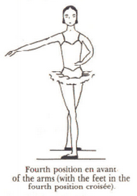
Our Work: Prepose
GESTURE fourth-position-en-avant:
POSE cross-legs-one-behind-the-other:
put your left ankle behind your right ankle,
put your left ankle to the right of your right ankle.
POSE high-arc-arms-to-right:
point your arms down,
rotate your right arm 70 degrees up,
rotate your left elbow 20 degrees to your left,
rotate your left wrist 25 degrees to your right.
EXECUTION:
cross-legs-one-behind-the-other,
high-arc-arms-to-right.
Notes:
Fix image

Slide 12
Understanding a Phrase in Prepose
rotate your left elbow 20 degrees to your left,
action
body part
angle
direction

Slide 13
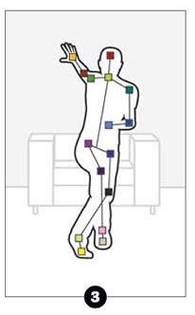
Runtime interpretation
actions are functions of the recognized skeleton
rotate your left elbow 20 degrees to your left
Our prototype hard codes verb implementations, but they could be sub-gestures created manually
“20 degrees” is an argument to the function “rotate”
“left” is an argument to the function “rotate”
Notes:
Represent the body by vectors
Coordinate system is based on user hips and world up vector

Slide 14
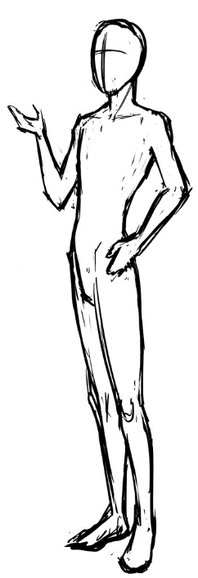
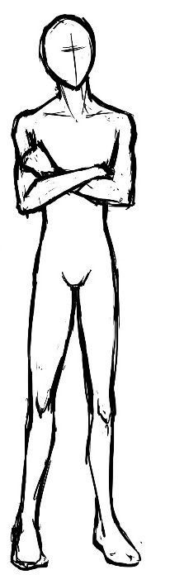
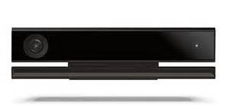
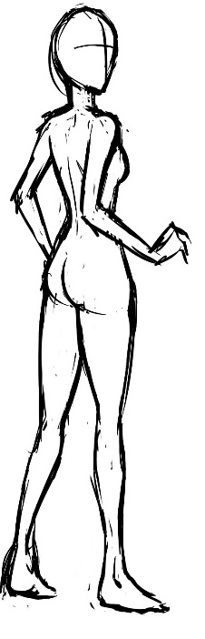

Prepose Architecture
Trust boundary
Prepose
interpreter
and
runtime
App 0
Prepose Code
App 1
Skeleton
App 2
Gesture Events
App 3
MSR Z3 constraint solver
App 4
Notes:
Important to note: the runtime is concurrently handling all the apps!

Slide 15
Demo
Notes:
print screen from the demo

Slide 16
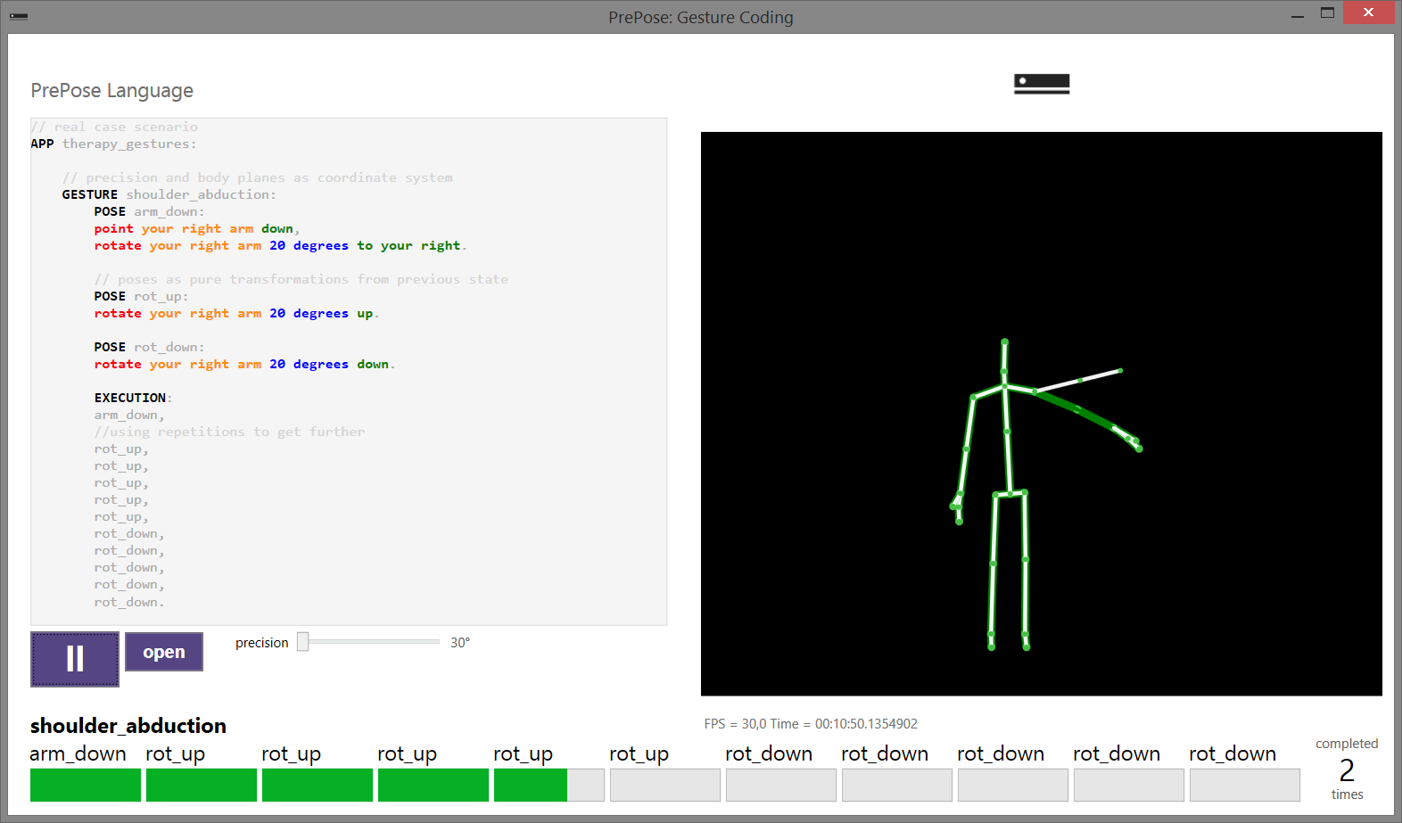
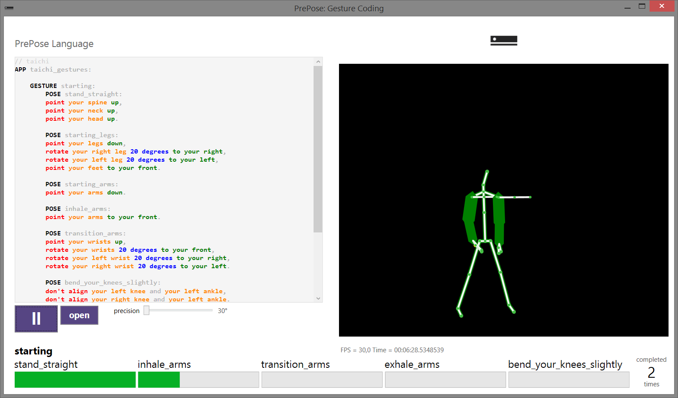
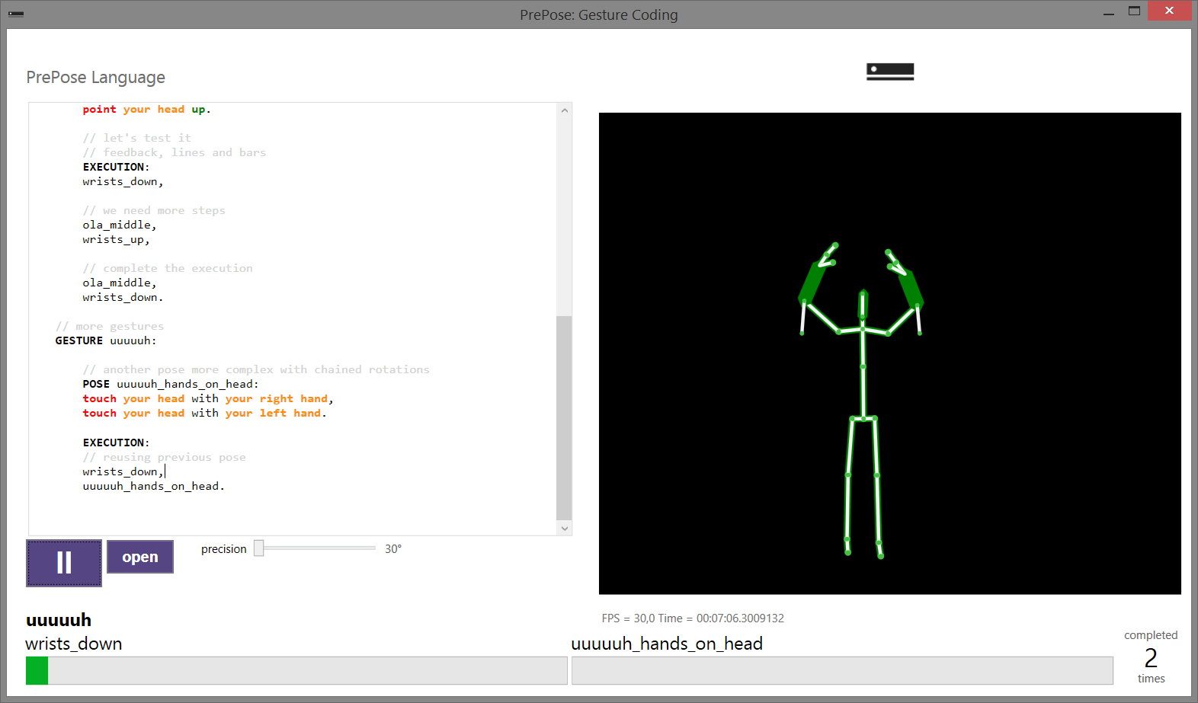
Print Screens

Slide 17
Complementary to Machine Learning
Declarative
Close to English
Easy to understand and refine
Fast coding and prototyping
Reusable components
Open to different interpretations of the underlying actions
Analysis Power
Safety
Conflict Detection
Target Generation

Slide 18
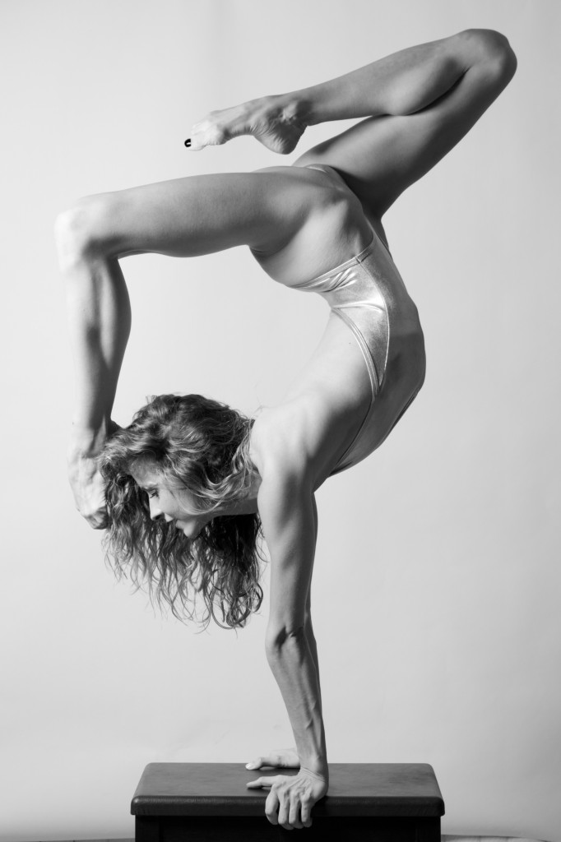
Static Analyses: Safety
Just because you can ask the user to make a gesture doesn’t mean you should.
Prepose can check if an app asks the user to move in a dangerous way.

Slide 19
CHecking Safety with Z3
Safety Check
assume that it is safe
GESTURE gesture:
EXECUTION:
step1,
step2.
ask if it is still safe
Spine Constraint
Body
Body
head x,y,z
neck x,y,z
spine x,y,z
…
if yes
Elbows Constraint
Shoulders Constraint
…

Slide 20
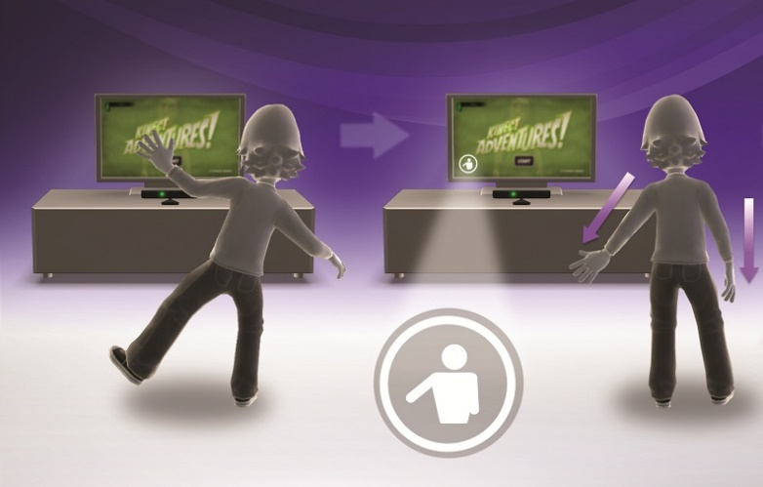
Static Analyses: Conflicts
Trust boundary
Prepose
Interpreter and Runtime
App 0
App 1
Prepose Code
App 2
App 3
Gesture Events
Do any apps try to override the system attention gesture?
Could any two gestures be triggered at the same time?
MSR Z3 Constraint Solver
App 4

Slide 21
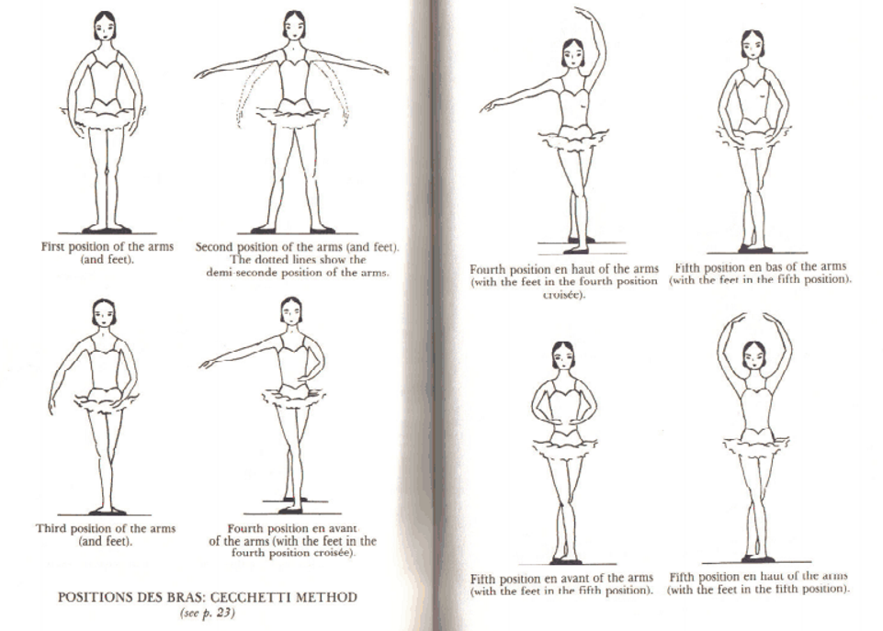
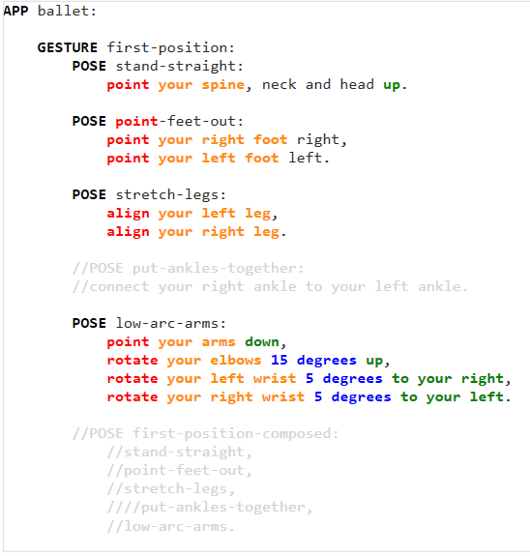
Expressiveness: Ballet
Body precision
Performance dance
Reusable partial poses
Notes:
code on the right
call-outs

Slide 22
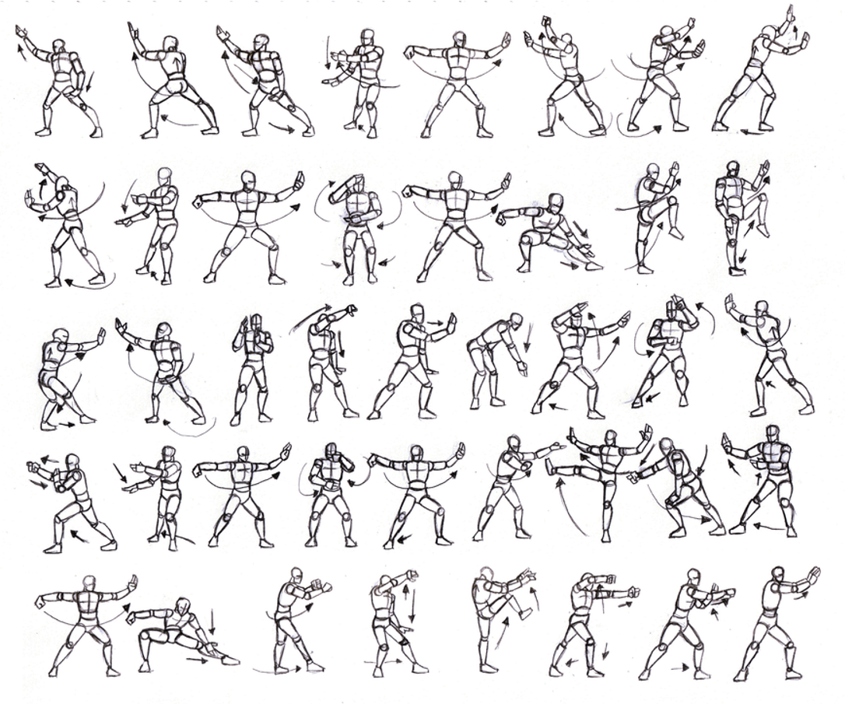
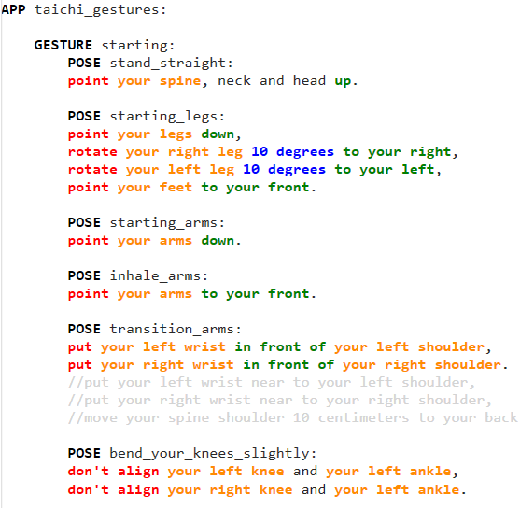
Expressiveness: Taichi
Relation between joints extensively explored
Martial arts
Complex gestures
Time constraints
Notes:
code on the right

Slide 23
Evaluation
Application | Gestures | Poses | LOC
Therapy | 12 | 28 | 225
Ballet | 11 | 16 | 156
Taichi | 5 | 32 | 314
Overall Performance
30 FPS
Online
Matching time: 3 ms
Pose transition: 91 ms
Offline
Safety: 725 ms
Conflicts: 52 sec

Slide 24
Conclusion
Novel way to write gesture recognizers
Complementary to existing machine learning approaches
Architecture protects privacy
Expressive enough for a wide class of gestures
Resulting recognizers run quickly
First gesture recognizers with precise static analyses

Slide 25
Future Work
Proper performance evaluation
Optimize Z3 solving steps
New actions to improve expressiveness
Make use of time based constraints
Provide hidden properties to apps
Build and submit one application using Prepose

Slide 26
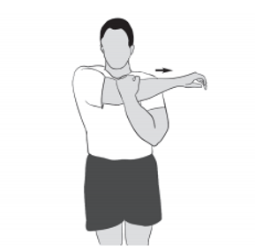
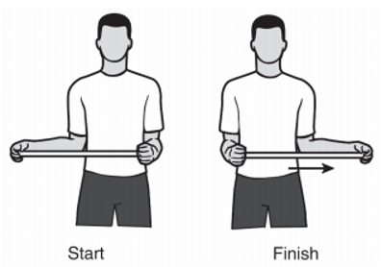
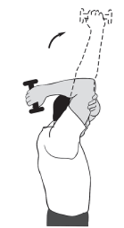
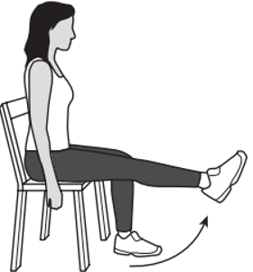
Physical therapy

Slide 27
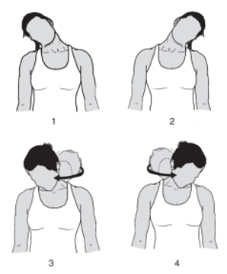
Complex gestures

